Slide 1



A Multi-Factor Data Analysis of Students’ Academic Performance
Adenike Awotunde
April 2025.

Slide 2



Introduction
There is a common belief that certain factors, such as taking up part-time jobs, engaging in extracurricular activities, or class absenteeism, negatively impact students’ academic performance. However, the extent of this impact remains uncertain. This analysis aims to investigate these claims, providing data-driven insights to determine their validity. The goal is to ensure that potential benefits associated with these factors are not overlooked while addressing any challenges they may pose to students' academic success.
This analysis was performed using python programming to load, clean, transform and analyze the data to generate insights with common python libraries such as NumPy, Pandas, Matplotlib and Seaborn.
The dataset used for this analysis was gotten from Kaggle and can be downloaded via this LINK. It contains college students' academic records with 2000 rows and 17 columns with features such as ‘id’, ‘first name’, ‘last name’, ‘gender’, ‘part time job’, ‘extracurricular activities and scores for subjects taken by the students.
Dataset Overview & Methodology

Slide 3
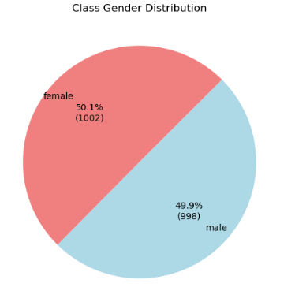
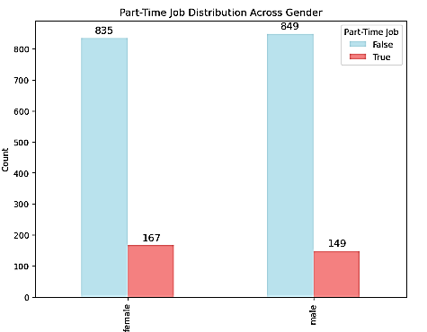
Key Insights
167 female students take up part time jobs while in school while there are 149 males doing same
The class is composed of 50.1% females and 40.9% males.

Slide 4
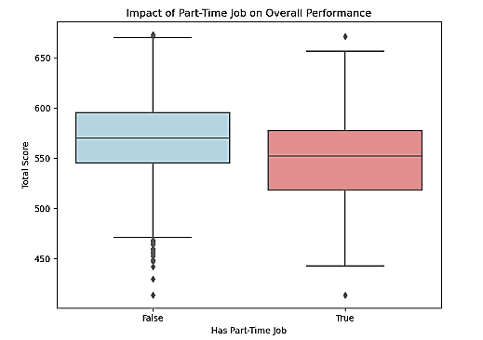
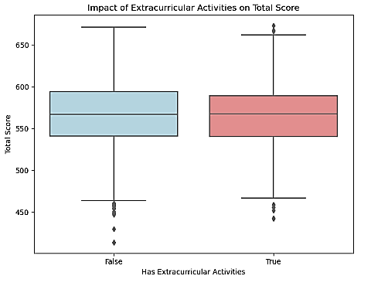
Key Insights
The mean total score for students who engage in extracurricular activities is 564.19 while for students who did not is 567.55
The maximum score for students with extracurricular activity is 673 while students without it had 671
The minimum score for students with extracurricular activity is 442 while students without it had 414
The mean total score for students with part time job is 548.03 while for students without part time job is 570.39.
The minimum total score for both groups is 414

Slide 5
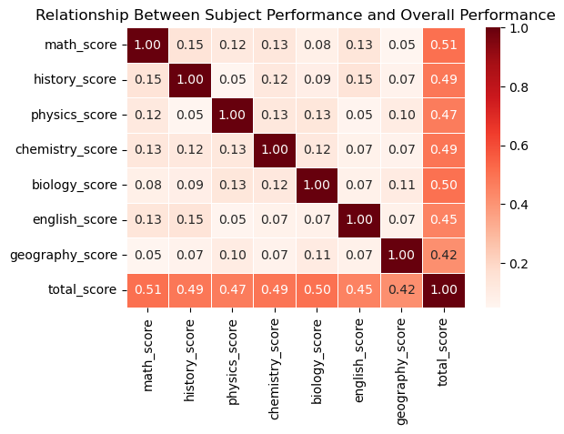
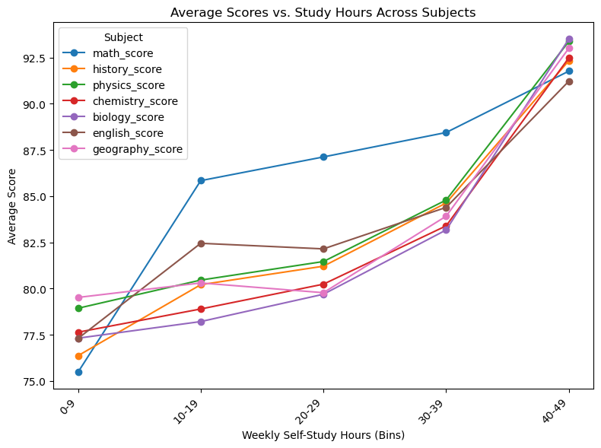
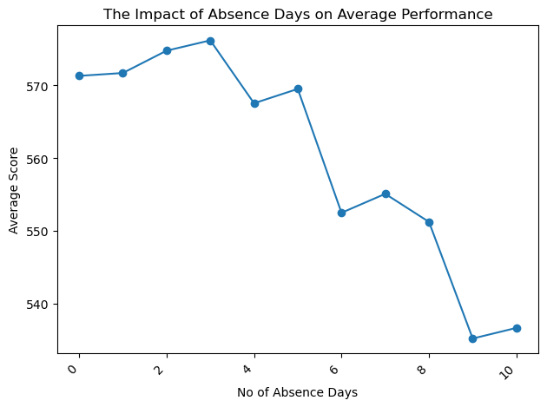
Key Insights
This chart shows that more self study hours lead to better performance across all subjects.
Math scores consistently remain the highest across all study hour groups.
Mathematics has the strongest correlation with the overall academic performance and Geography has the least.
Students with more absence days tend to score lower.

Slide 6



Conclusion
Increased self-study hours have a strong positive impact on academic performance.
Students who dedicate more time to independent study tend to achieve higher scores.
Working part-time as a student generally has a negative impact on overall academic performance, though good time management can mitigate this.
Regular class attendance is crucial to achieving academic success
Involvement in extracurricular activities appears to have a positive effect on academic performance, possibly due to improved time management, discipline, and cognitive skills.

Slide 7
Recommendations
As self-study and class attendance appear to be strongest predictors of academic success, students should prioritize regular class attendance and dedicate consistent time to personal study.
The school should encourage students’ participation in extracurricular activities because of the benefits it offers in developing cognitive skills that can help in overall academic performance. This however should be balanced with teaching the students time management skills.
Indigent students needing financial support can be encouraged to engage in part time jobs with proper planning and time management. Non-indigent students, however, should focus fully on their studies for better academic outcomes.
THANK YOU FOR YOUR ATTENTION

